Slide 1







Vietnam - Korea University of Information and Communications Technology
ĐỒ ÁN CƠ SỞ 2:
ĐỀ TÀI:
XÂY DỰNG ỨNG WEBSITE BÁN HÀNG MỸ PHẨM
Sinh viên thực hiện : VĂN TRỌNG HUY
Mã sinh viên : 23AI018
GVHD : ThS.TRẦN THANH LIÊM

Slide 2



INTRODUCTION:
OBJECTIVES OF THE WEBSITE
1.
CHALLENGES AND SOLUTIONS
4.
2.
BENEFITS OF THE WEBSITE
FEATURES OF THE WEBSITE KEY
5.
6.
CONCLUSION
3.
TECHNOLOGIES USED

Slide 3


INTRODUCTION TO THE TOPIC:
Our website is an e-commerce platform dedicated to cosmetics and beauty products. It is designed to provide customers with a wide variety of options, ranging from skincare essentials to makeup products and haircare solutions.

Slide 4

I. Objectives of the Website
The primary goal of the website is to create an online platform where customers can:
Explore a variety of cosmetic products, including makeup, skincare, and haircare items.
Easily find promotions and discounts.
Purchase products online with secure payment options or reserve them for in-store pickup.
Learn more about beauty trends through blogs or tutorials.

Slide 5
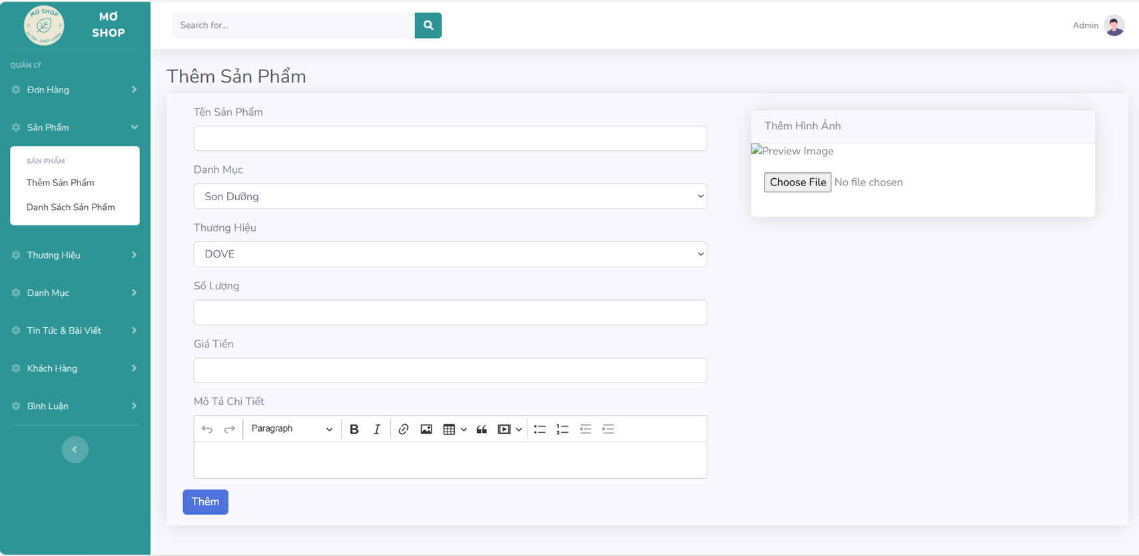
II. Key Features of the Website
1. Admin Features
Manage Products: Add, edit, and delete products, including updating their details, prices, and images.

Slide 6
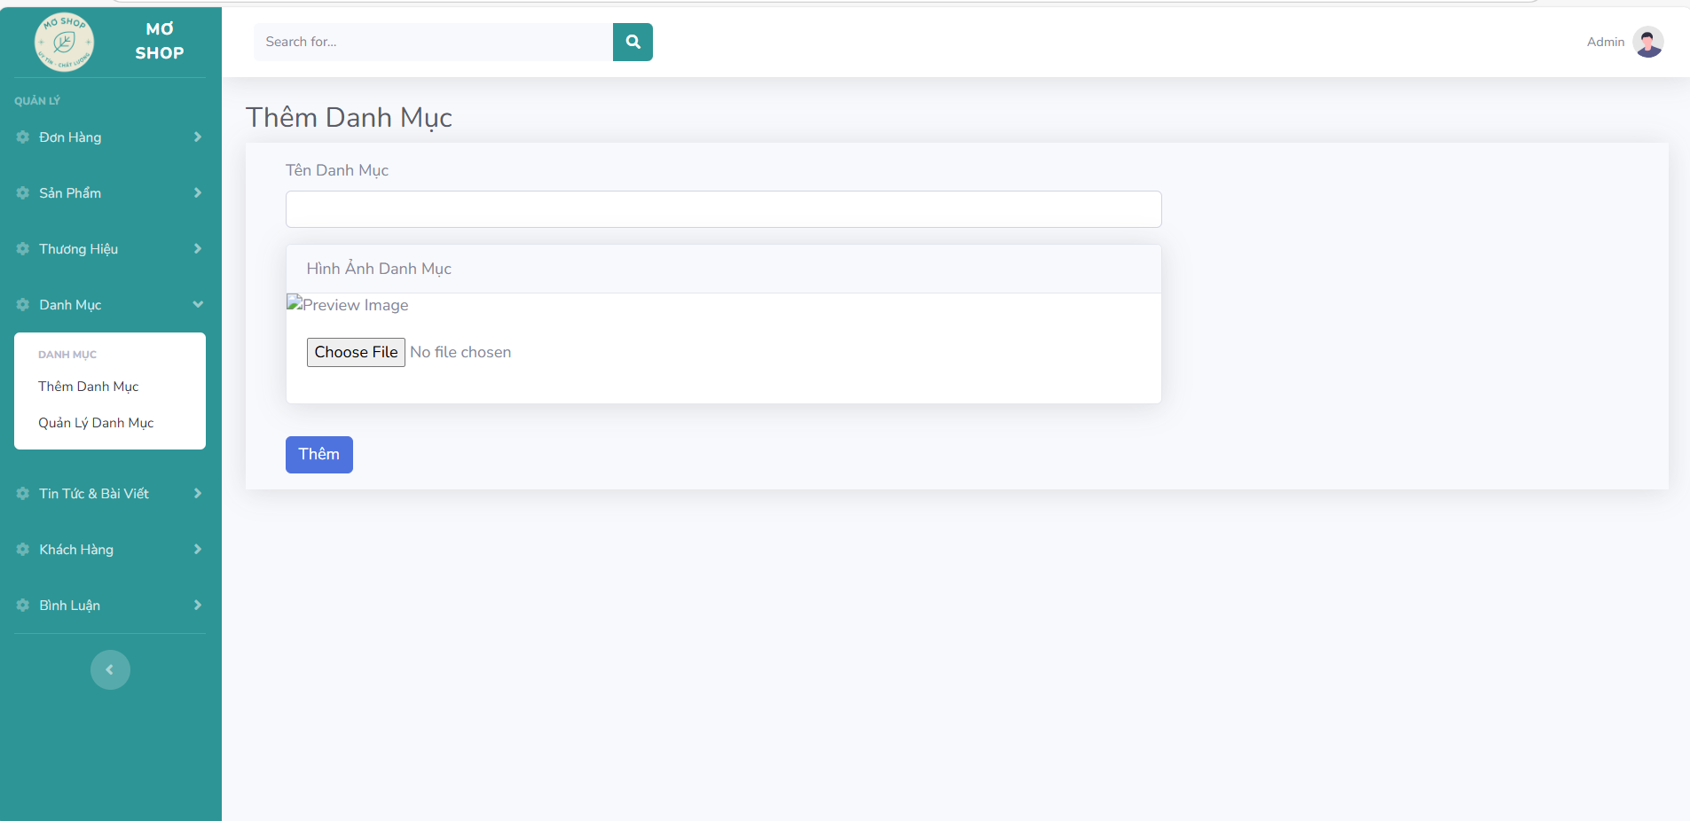
II. Key Features of the Website
1. Admin Features
Manage Categories: Add, edit, and delete product categories for better product organization.

Slide 7
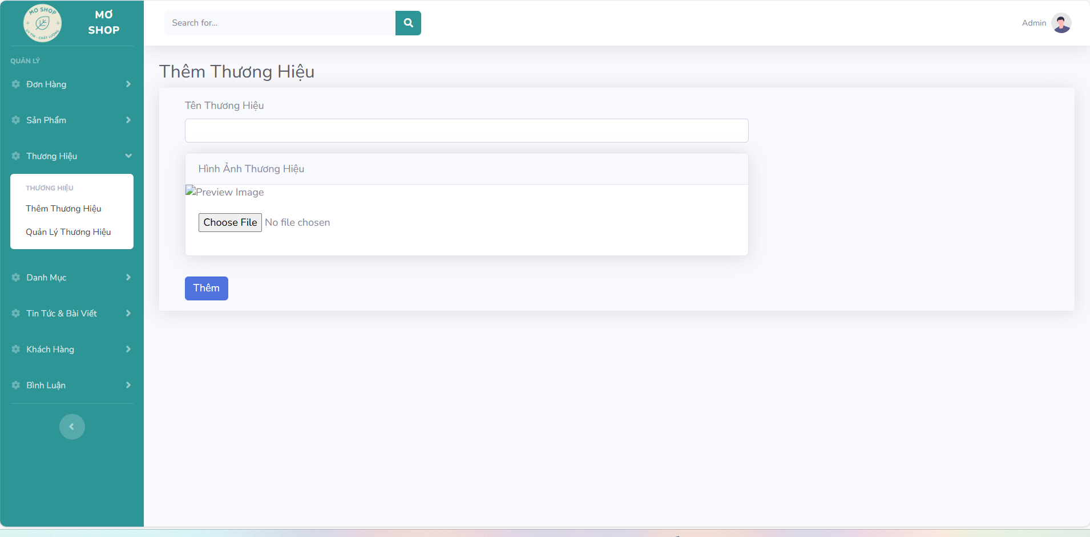
II. Key Features of the Website
1. Admin Features
Manage Brands: Add, edit, and delete product brands.

Slide 8
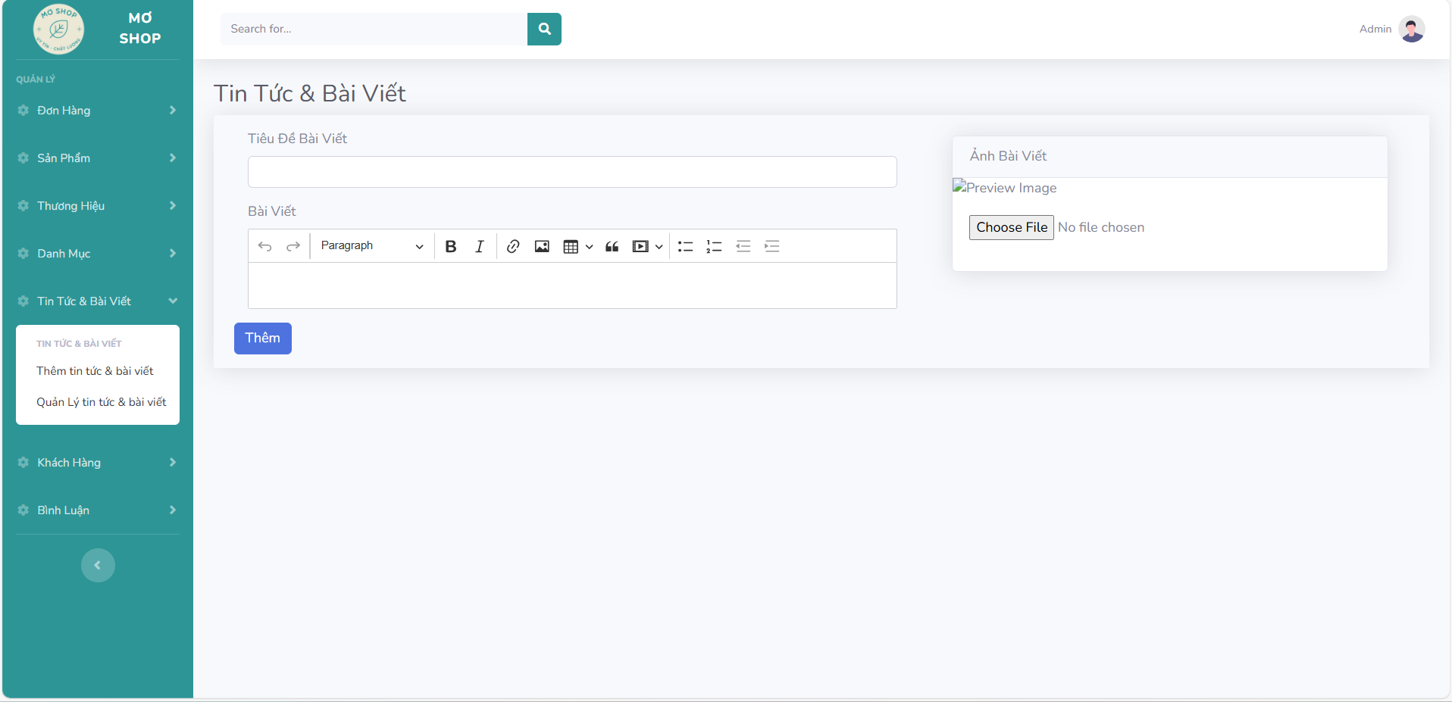
II. Key Features of the Website
1. Admin Features
Manage Blog Posts: Create, edit, and delete blog posts or news articles to keep customers informed.

Slide 9
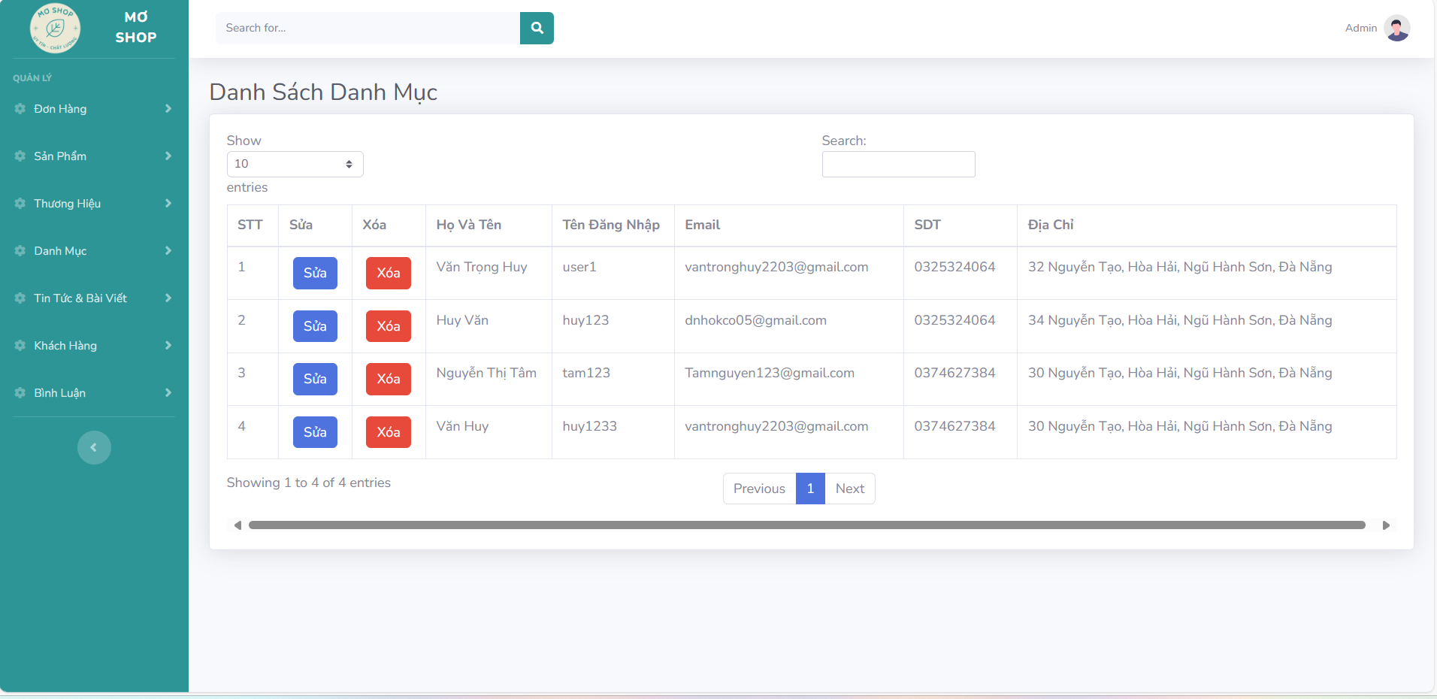
II. Key Features of the Website
1. Admin Features
Manage Customers: View and manage customer accounts and their activity.

Slide 10
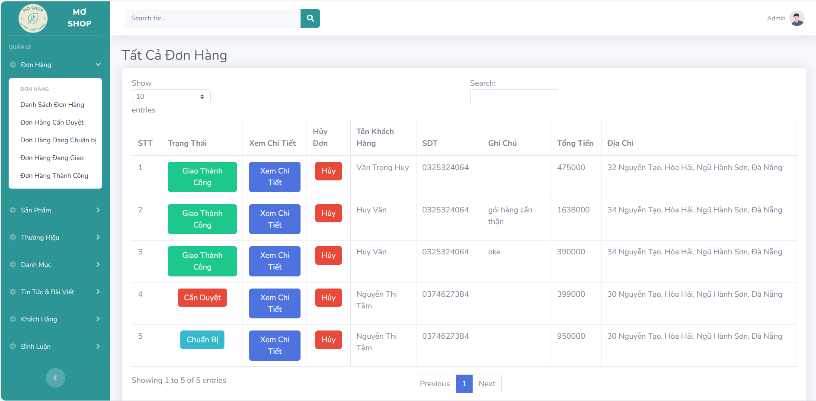
II. Key Features of the Website
1. Admin Features
Manage Orders: Track, update, and process customer orders efficiently.

Slide 11
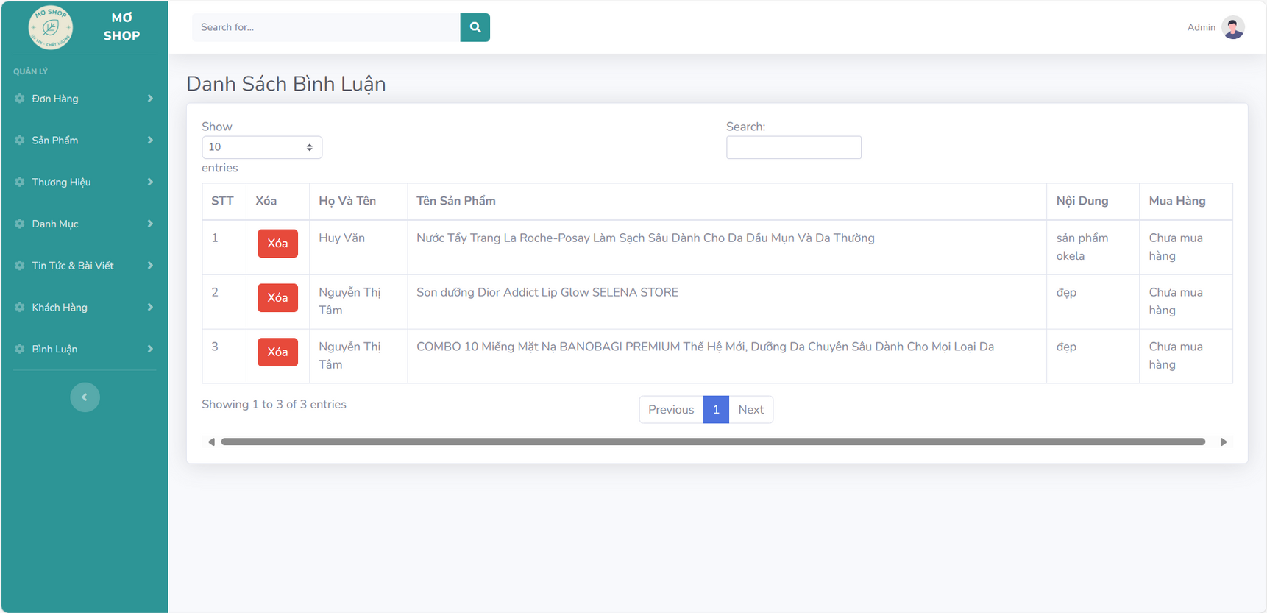
II. Key Features of the Website
1. Admin Features
Manage Comments and Reviews: Approve, delete, or reply to customer comments and product reviews.

Slide 12
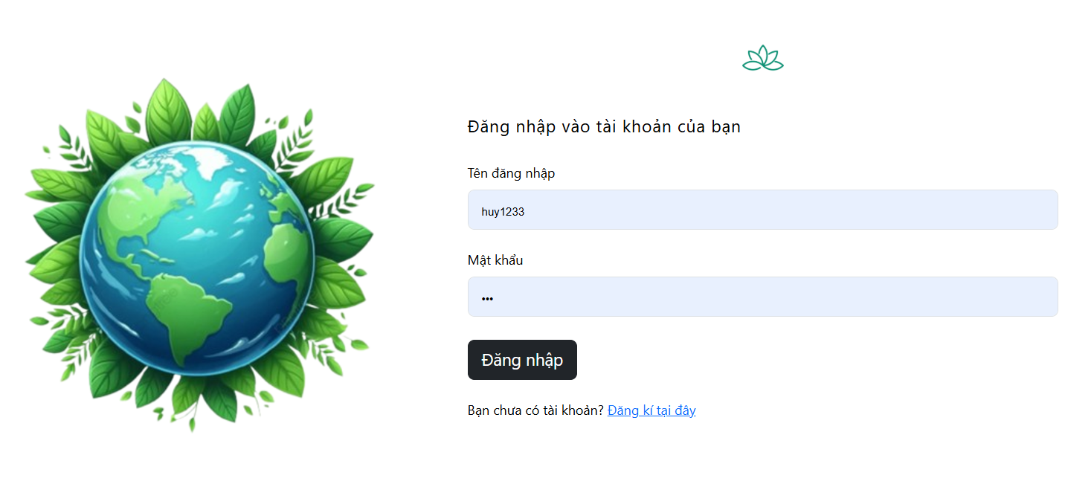
II. Key Features of the Website
2. Customer Features:
The website offers customers a seamless and engaging shopping experience with the following features:
Login and Account Management: Customers can create accounts, log in, and manage their personal details.

Slide 13
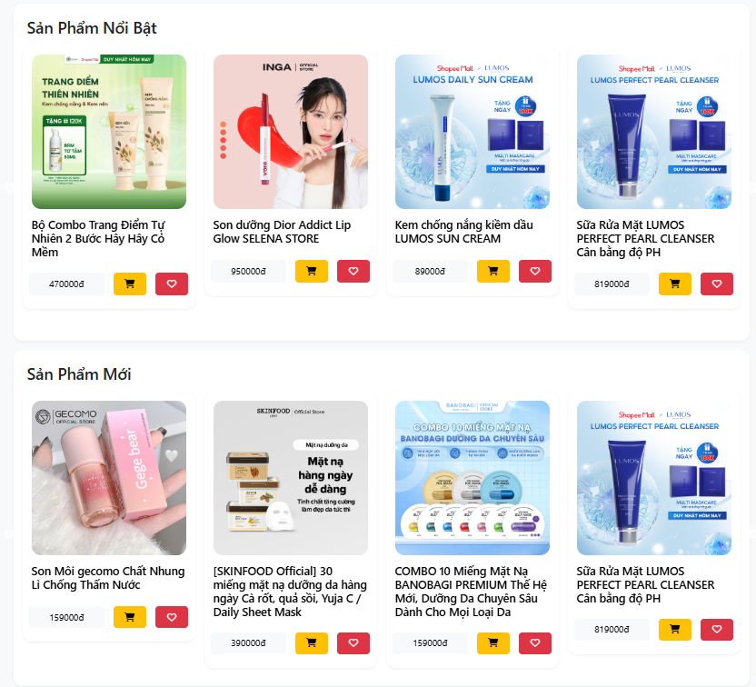
II. Key Features of the Website
2. Customer Features:
View Products: View and explore a variety of products with detailed descriptions and images.

Slide 14
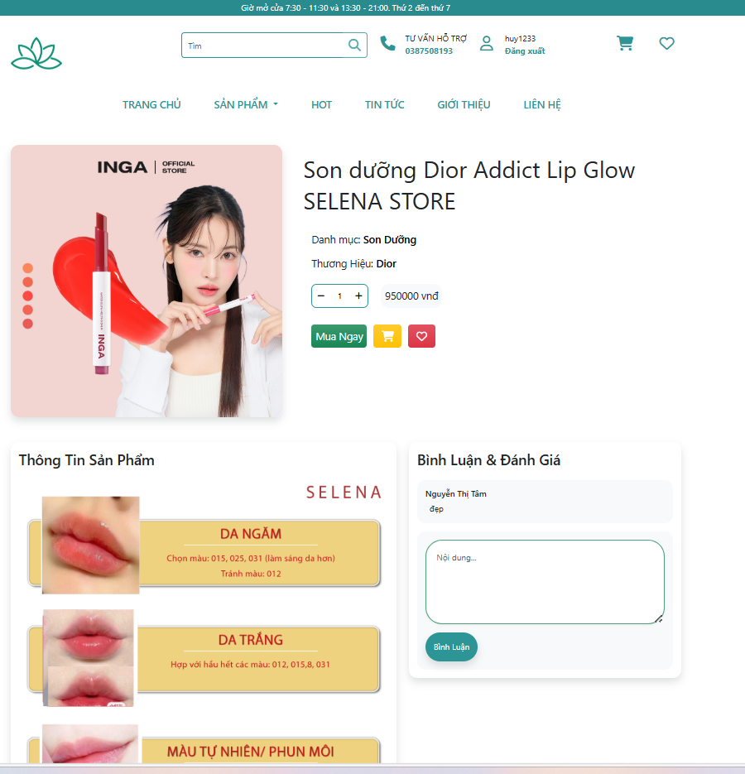
II. Key Features of the Website
2. Customer Features:
Shopping and Checkout: Add products to the cart, choose desired options (e.g., quantity, color), and complete purchases easily.

Slide 15
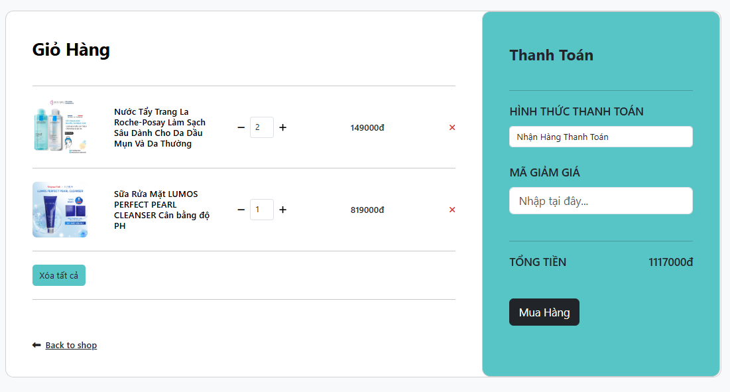
II. Key Features of the Website
2. Customer Features:
Cart Management: Review and manage items in the shopping
cart before checkout.

Slide 16
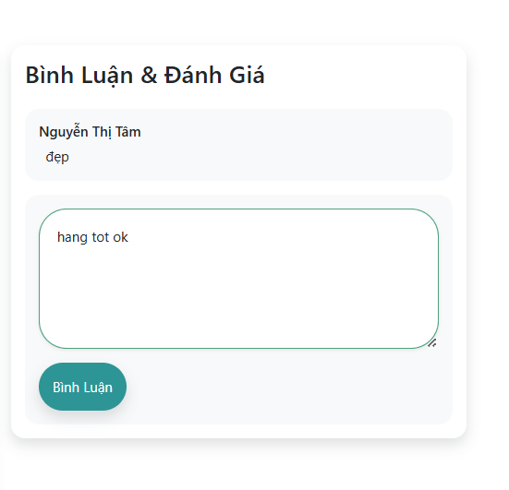
II. Key Features of the Website
2. Customer Features:
Product Reviews : Leave comments and rate products based on personal experience.

Slide 17
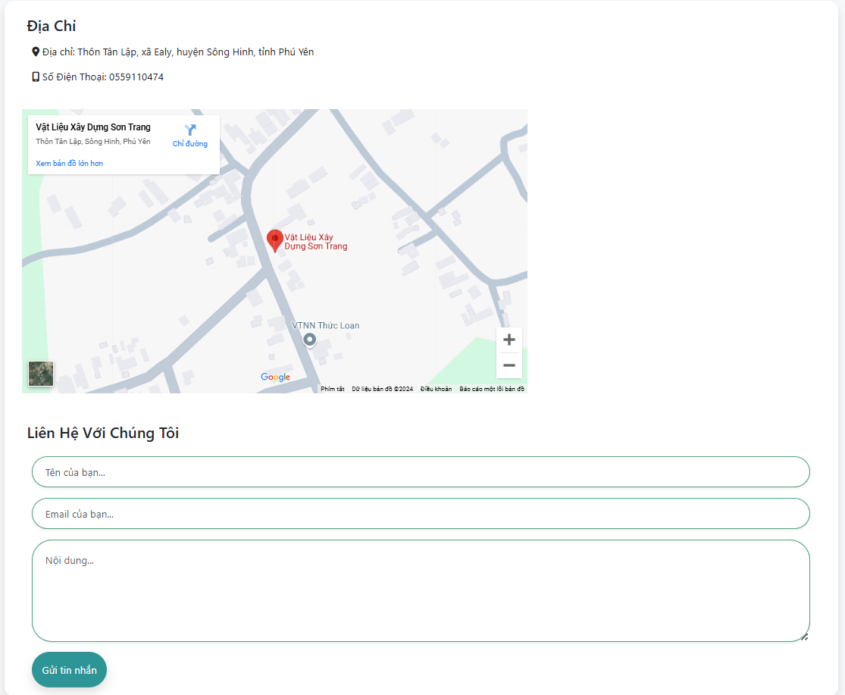
II. Key Features of the Website
2. Customer Features:
Contact Support: Reach out to sellers for assistance or inquiries via a contact form or support chat.

Slide 18
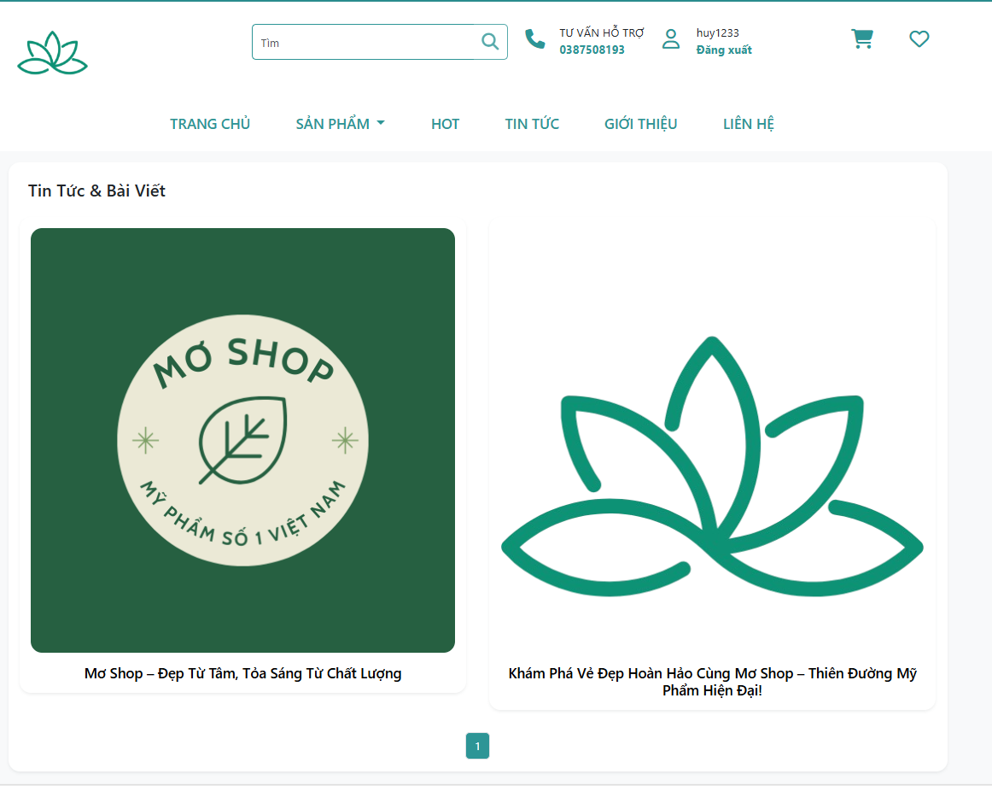
II. Key Features of the Website
2. Customer Features:
Read News and Updates: Stay updated with the latest shop announcements, promotions, and beauty tips through the blog section.

Slide 19
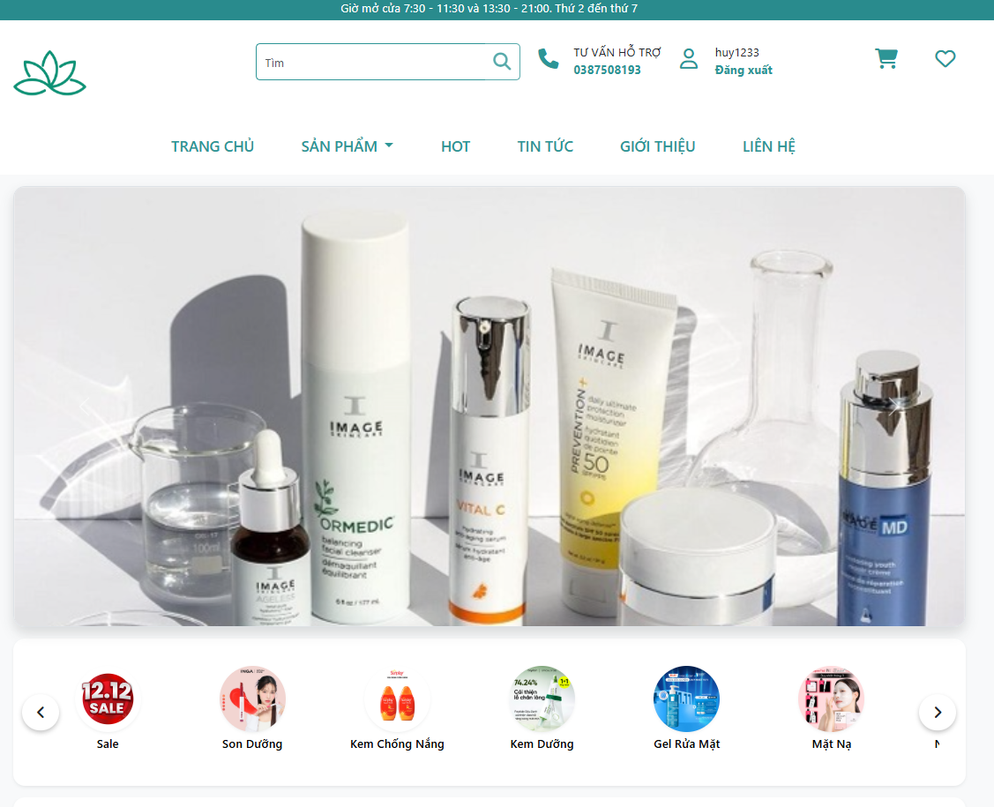

II. WEB INTERFACE
1.Home Page:

Slide 20
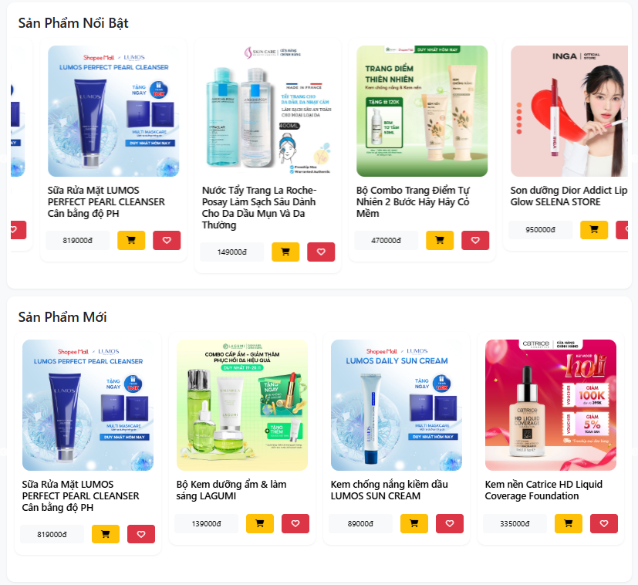
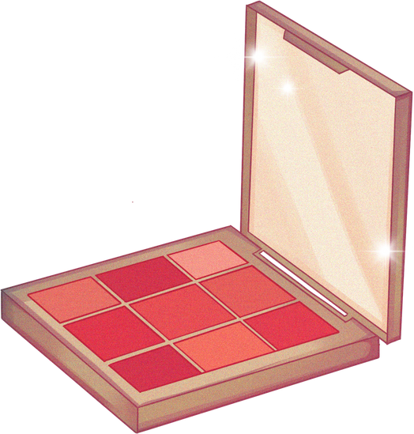
II. WEB INTERFACE
2. Product Page:

Slide 21
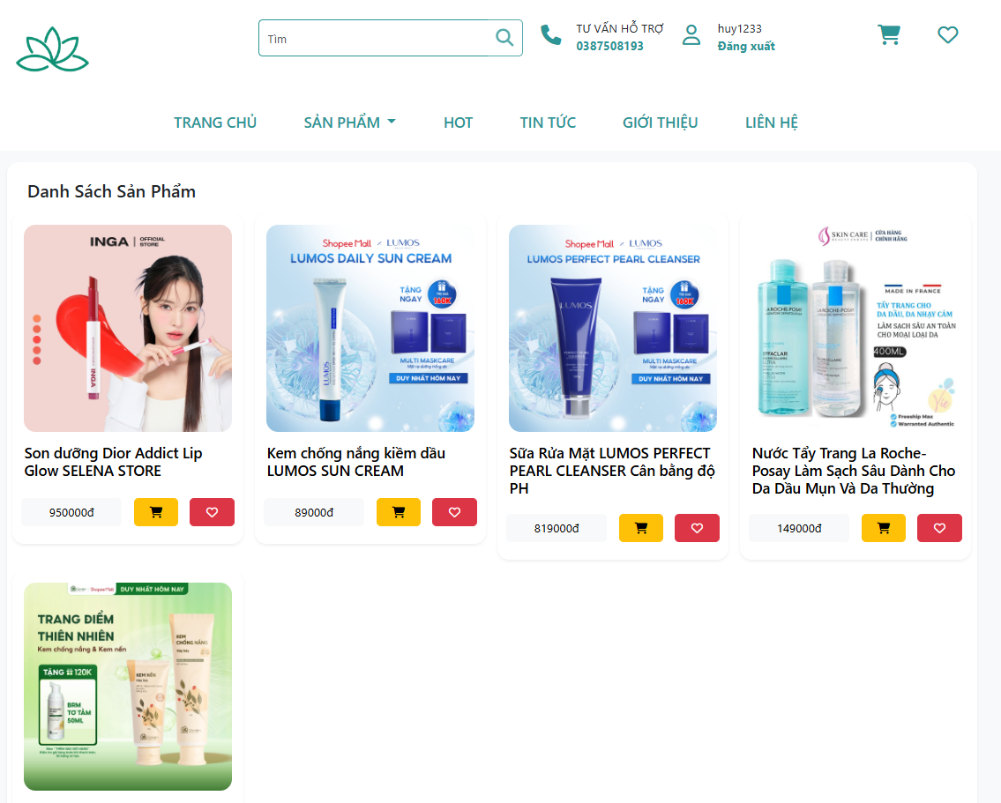

II. WEB INTERFACE
3. Featured Products:

Slide 22
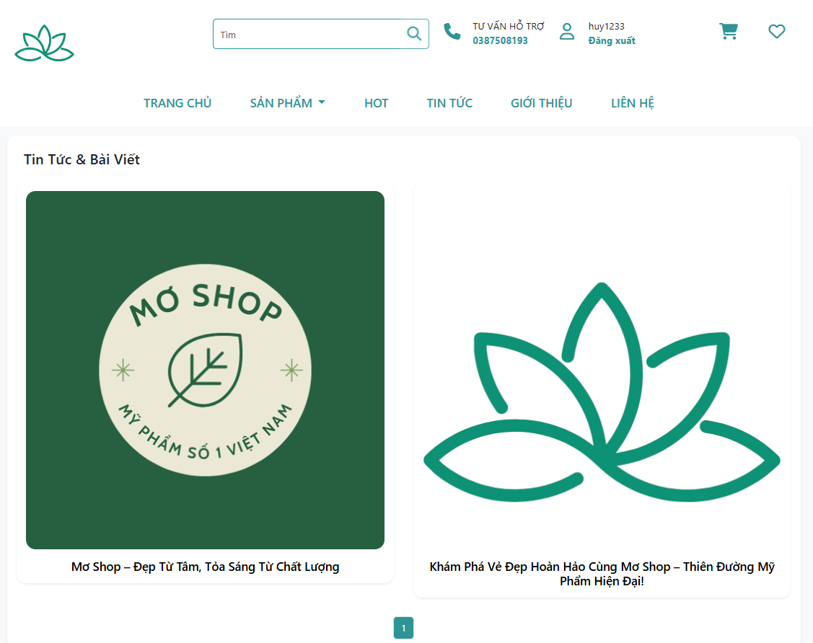

II. WEB INTERFACE
4. News Page:

Slide 23
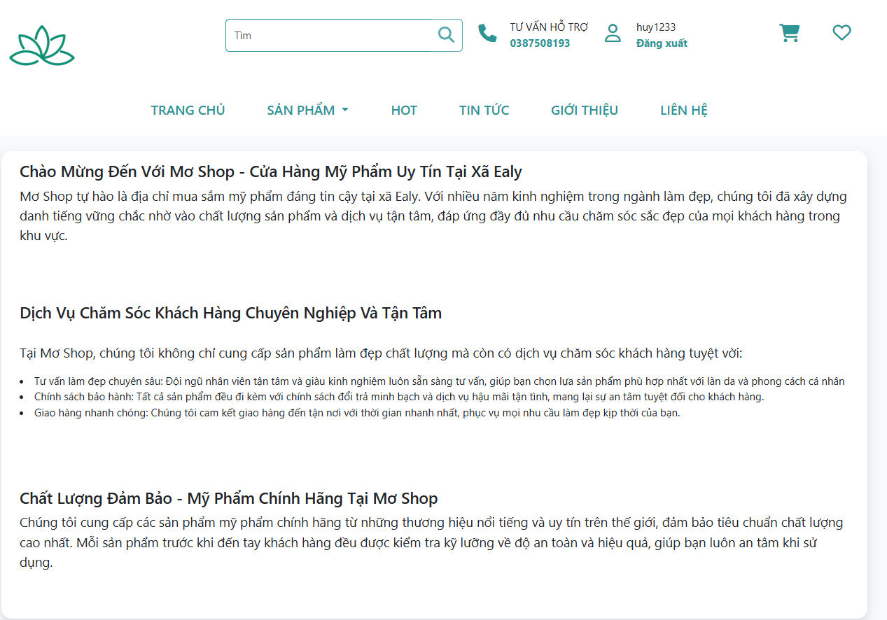

II. WEB INTERFACE
5. About Us Page:

Slide 24
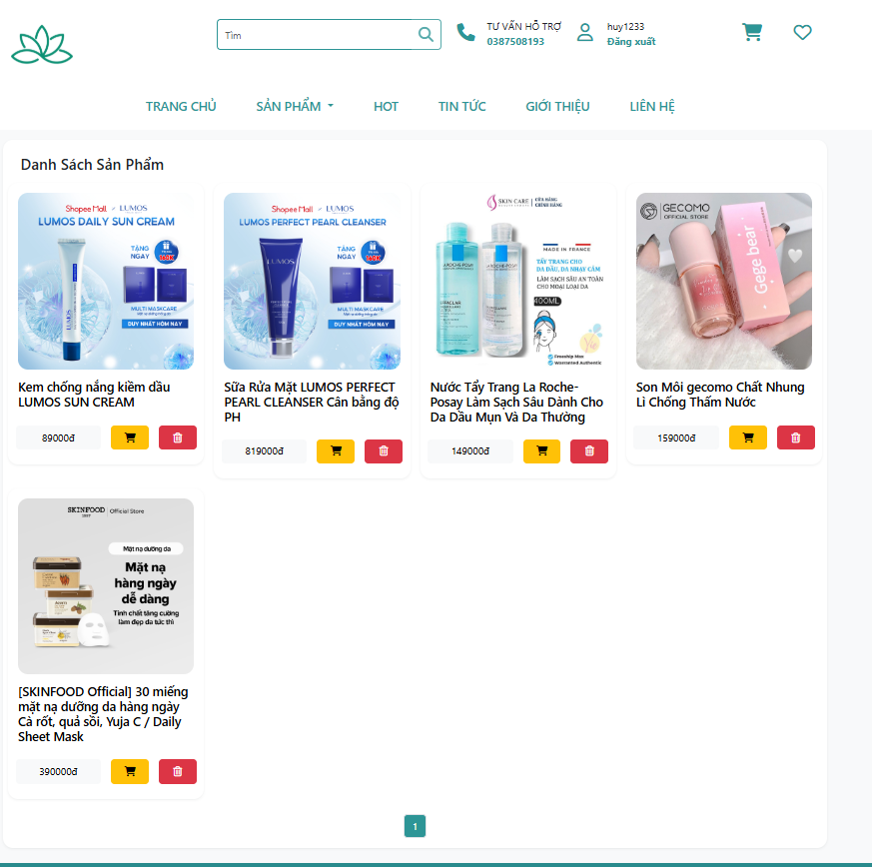

II. WEB INTERFACE
6. Wishlist:

Slide 25






III. Technologies Used
The website is built using:
Frontend: HTML, CSS, JavaScript, and frameworks like Bootstrap for a modern and responsive design.
Backend: PHP and MySQL to handle data management and ensure smooth functionality.
Tools: Platforms like IntelliJ IDEA and Laragon for development and testing.

Slide 26


IV. Challenges and Solutions
Building the website came with several challenges:
Ensuring Fast Loading Times: We optimized images and scripts to improve performance.
Secure Transactions: We integrated SSL certificates and a trusted payment gateway to protect customer data.
Product Image Display Issues: Debugging image upload errors to ensure all product details are displayed correctly.

Slide 27
V. Benefits of the Website
This website brings several advantages to the business:
Increased Accessibility: Customers can shop anytime, anywhere.
Brand Visibility: An attractive website enhances the brand image and attracts new customers.
Data Analytics: The admin panel helps the business analyze sales trends and customer preferences.

Slide 28

Conclusion
Product Overview:
In conclusion, building an e-commerce website for cosmetic products is a strategic move for any business looking to grow in the digital age. With a focus on user experience, security, and functionality, such a platform not only satisfies customer needs but also drives business success.
Thank you for your attention. I’m happy to answer any questions you may have.

Slide 29

THANK FOR LISTENING!
CONTACT ME:
Email
vantronghuy2203@gmail.comn
Mạng xã hội
@htpps://www.facebook.com/Huyv.2203
Điện thoại
0325324064

